Slide 1



Concourse
CI that scales with your project
Patrick Crocker
Advisory Platform Architect | Pivotal

Slide 2
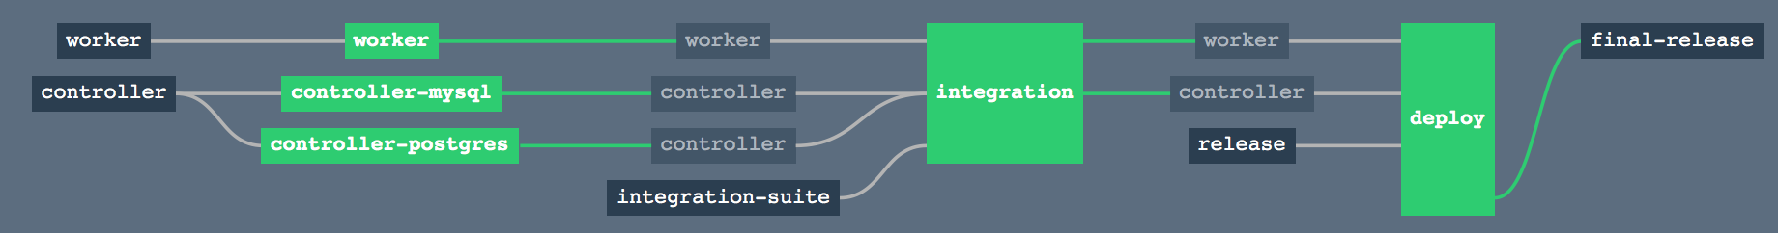
Continuous Integration & Delivery
Benefits
AUTOMATION.
Integrate tools and automate processes from testing to builds and deployment
SPEED.
Release more frequently with smaller bits will reduce complexity and improve time-to-market
QUALITY.
Reduce feedback loop using test-driven development to surface problems sooner and be responsive
AGILITY.
Push updates on regular basis with no downtime to improve customer experience and time to market
Concepts
Commit Code Change
Automate Build & Test
Store Binaries & Build Artifacts
Automated Integration Testing
Acceptance, Performance & Load
Zero Downtime Upgrade to Production
Pipeline
Notes:
Continuous Integration (CI) is a development practice that requires developers to integrate code into a shared repository several times a day. Each check-in is then verified by an automated build, allowing teams to detect problems early.
Continuous Delivery is the natural extension of Continuous Integration: an approach in which teams ensure that every change to the system is releasable, and that we can release any version at the push of a button. Continuous Delivery aims to make releases boring, so we can deliver frequently and get fast feedback on what users care about.
Concourse enables CI/CD by realizing the conceptual delivery model in visual pipelines.

Slide 3


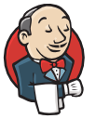

Why Concourse?
Hudson
Travis CI
Jenkins
Notes:
Why Concourse? Why build another CI System?
Concourse is a response to the interesting CI and CD challenges encountered while working on the Cloud Foundry project. Cloud Foundry projects and their tests needed to run on different architectures, different platforms, against varying underlying IaaSs before being tested that they could be deployed fresh while also remaining compatible with upgrades from previous versions.
We went through various different generations of our CI infrastructure and were never completely happy with one (or in some cases many) aspects of each attempt.

Slide 4

What we found in other CI systems
Snowflakes
lots of plugins
system dependencies
textbox scripting
Usability
complicated UIs
endless menus
too many clicks to get logs
Pipelines
no first-class support
complex job sequencing
Execution Hierarchy
deep and complex
Environment Parity
works locally, breaks on server
lots of debugging commits
Scalability
hard to scale vertically or horizontally
Notes:
http://concourse.ci/concourse-vs.html

Slide 5

What if we could...
Configurable
declarative CI (no more snowflakes)
store in version control
Usability
visualize pipeline
simple ui (click less!)
Unpolluted builds
previous builds do not affect subsequent builds
Scalability
scale up to increase performance
scale down to decrease cost
Environment Parity
run tasks locally before committing
Notes:
http://concourse.ci/concourse-vs.html

Slide 6
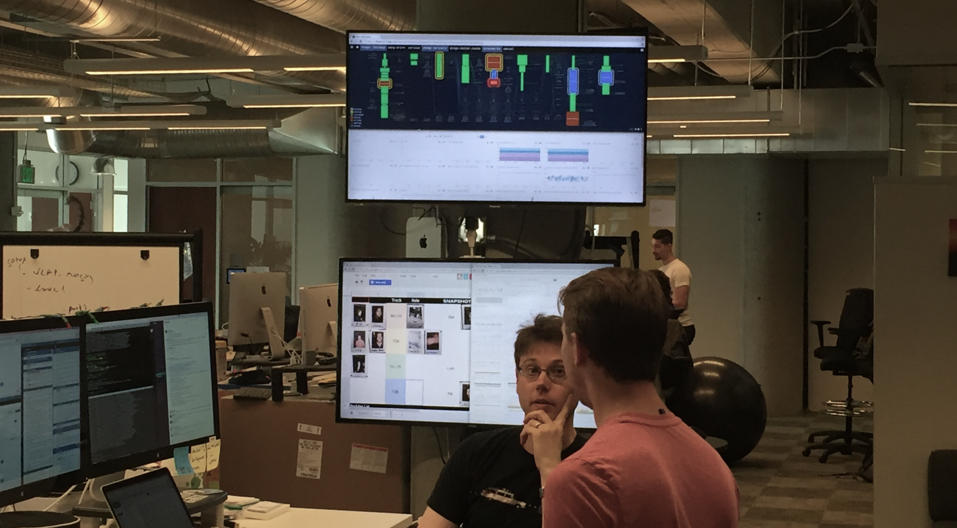

Slide 7
Concourse Principles
Simple
Concourse is a response to the complexity introduced by other systems. It is built on the idea that the best tools can be learned in one sitting.
Usable
Concourse is optimized for quickly navigating to the pages you most care about. From the main page, a single click takes you from a pipeline view to the log of a job's latest failing build.
Isolated Builds
Every build task is executed in a container defined by its own configuration, by stateless workers. This eliminates build pollution and ensures multiple teams can use the same Concourse deployment without worrying about the state of the worker VMs.
Notes:
http://concourse.ci/what-and-why.html

Slide 8
Concourse Principles
Scalable, reproducible deployment
No Concourse deployment is a snowflake. There are no boxes to check; no configuration happens at runtime.
Flexible
Features that other systems implement in the core of the product, Concourse implements in "userland", as resources. This keeps the core of Concourse small and simple, and proves out the extensibility introduced by this simple interface.
Local iteration
Concourse supports running one-off builds from local task configuration that allows you to trust that your build running locally runs exactly the same way that it runs in your pipeline.
Notes:
http://concourse.ci/what-and-why.html

Slide 9
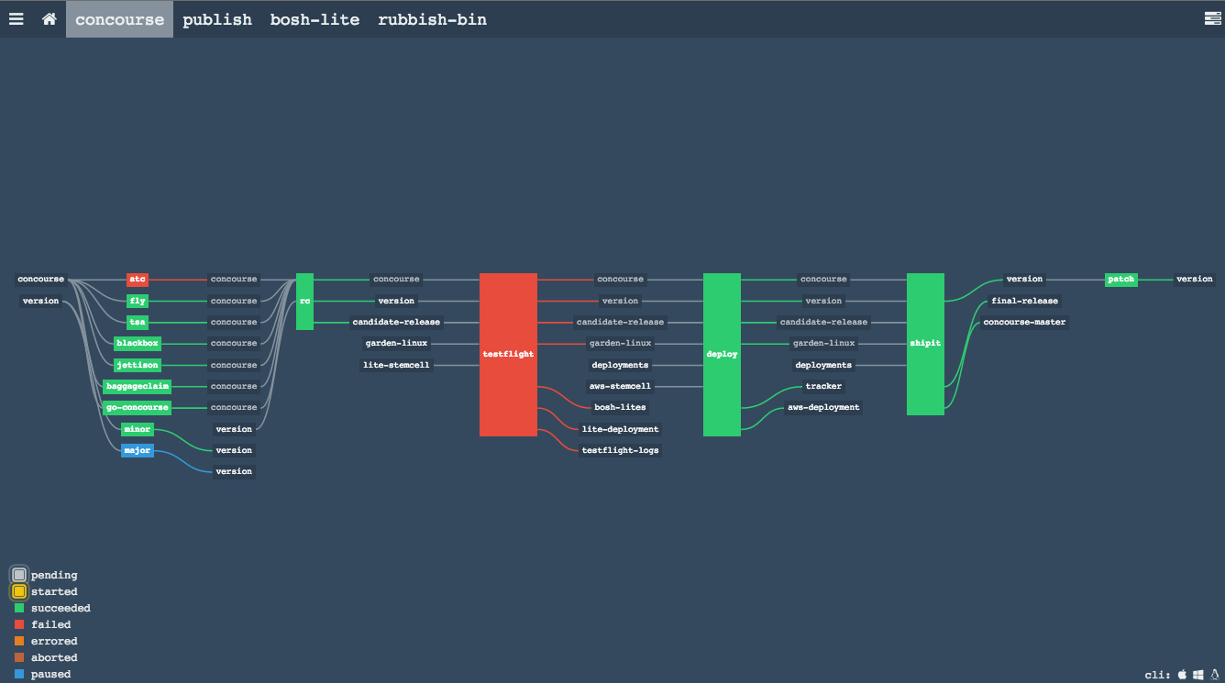
Notes:
Anger Optimized UI - You shouldn’t get angry at your CI because you can’t find the broken build in your pipeline, or click through a lot of menus to get to the logs. Concourse provides an intuitive view of your pipeline to let you know the current state at a glance.

Slide 10
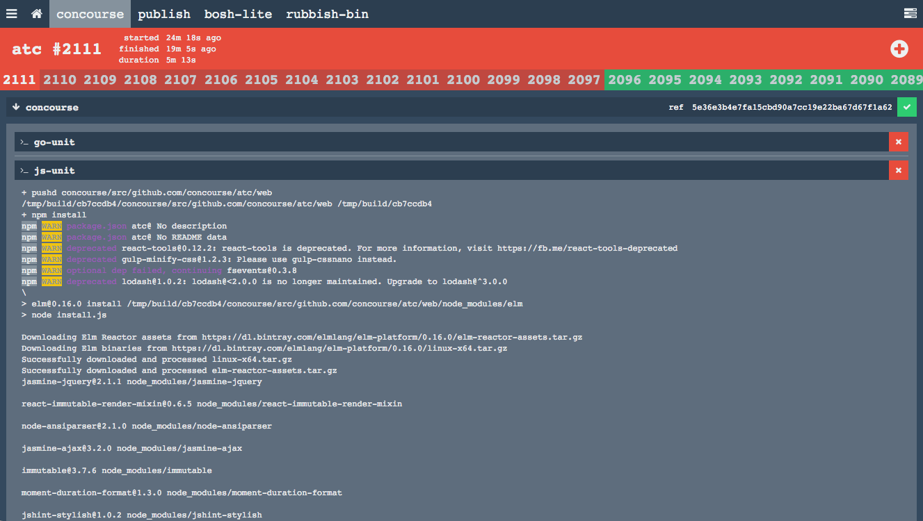
Notes:
A single click of a job in the pipeline shows current build status, including terminal colors and formatting (a helpful feature lacking in some other CI tools!).

Slide 11
Concourse Concepts: simple primitives
resources
detecting, fetching, creation of externally versioned “things”
jobs
compose resources and tasks together to do something (run tests, ship, etc.)
tasks
run a script in a container with its dependent inputs
# pipeline.yml
resources:
- name: source-code
type: git
source:
uri: https://github.com/...
branch: master
# pipeline.yml
jobs:
- name: unit
plan:
- get: source-code
trigger: true
- task: unit-tests
file: source-code/ci/unit.yml
# unit.yml
platform: linux
image_resource:
type: docker-image
source:
repository: java
tag: '8'
inputs:
- name: source-code
run:
path: source-code/mvnw
args: [ clean, test ]
Notes:
A resource is identified by an arbitrary name which is used in jobs and tasks
Define a resource (source-code) -> Get the resource -> Use the resource

Slide 12
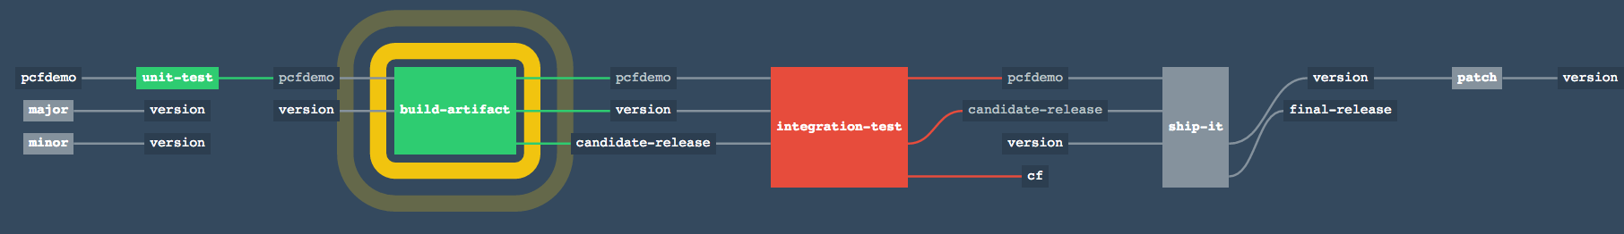
Concourse Concepts: pipelines
the resulting flow of resources through jobs
fancy visualization UI for build monitor
many isolated pipelines per deployment

Slide 13
Concourse Concepts: reproducible deployment
no clicking through wizards to configure
Concourse pipelines are just config files
deploy cluster with PCF, BOSH, or Vagrant
workers are stateless
reproducible deployment
and configuration
infrastructure failure resilient
=

Slide 14
Concourse Concepts: reproducible builds
never hand-configure workers again
all builds run in stateless containers
one-off builds with custom inputs (local bits)
no ability to rely on CI state
portable CI scripts with
decent abstractions, less
coupled to Concourse
=

Slide 15
Concourse Concepts: resources
encapsulation of some external resource
replaces plumbing scripts
results in intuitive pipeline semantics
many first-class concepts from other systems are implemented in terms of resources (ex: timed triggers)
only pluggable interface

Slide 16
Concourse Concepts: resource interface
get :: version -> input
put :: output -> version
check :: version? -> [version]
ex: git resource:
get = git clone git@github.com:...
put = git push origin [branch]
check = git pull && git log abcdef..HEAD

Slide 17
Concourse Concepts: available resources
git repo
s3 bucket
docker image
bosh deployment
bosh.io release
bosh.io stemcell
Pivotal Tracker
github release
cf app
vagrant cloud/atlas
time
semver
more coming: twitter, email, github-pr, rubygems, ...

Slide 18
fly execute: run task with local bits
~/git/PCF-demo » fly -t lite execute -c ci/tasks/build.yml -i pcfdemo=.
executing build 92
% Total % Received % Xferd Average Speed Time Time Time Current
Dload Upload Total Spent Left Speed
100 58.8M 0 58.8M 0 0 28.1M 0 --:--:-- 0:00:02 --:--:-- 28.1M
initializing with docker:///java#8
running pcfdemo/ci/tasks/build.sh
[INFO] Scanning for projects...
[INFO]
[INFO] ------------------------------------------------------------------------
[INFO] Building pcf-demo 1.0.0-BUILD-SNAPSHOT
[INFO] ------------------------------------------------------------------------
...
[INFO] Packaging webapp
[INFO] Assembling webapp [pcf-demo] in [/tmp/build/e55deab7/pcfdemo/target/pcfdemo]
[INFO] Processing war project
[INFO] Copying webapp resources [/tmp/build/e55deab7/pcfdemo/src/main/webapp]
[INFO] Webapp assembled in [61 msecs]
[INFO] Building war: /tmp/build/e55deab7/pcfdemo/target/pcfdemo.war
[INFO] WEB-INF/web.xml already added, skipping
[INFO] ------------------------------------------------------------------------
[INFO] BUILD SUCCESS
[INFO] ------------------------------------------------------------------------
[INFO] Total time: 33.423 s
[INFO] Finished at: 2016-02-03T12:56:54+00:00
[INFO] Final Memory: 20M/217M
[INFO] ------------------------------------------------------------------------
succeeded

Slide 19
fly hijack: hop into build’s container
~/git/PCF-demo » fly -t lite hijack -j pcfdemo/build-artifact
1: build #10, step: version, type: get
2: build #10, step: prepare-build, type: task
3: build #10, step: candidate-release, type: put
4: build #10, step: version, type: put
5: build #10, step: pcfdemo, type: get
6: build #10, step: version, type: get
7: build #10, step: candidate-release, type: get
8: build #10, step: build, type: task
choose a container: 2
root@bqvgog0t9s0:/tmp/build/5020c204# ls -al
total 8644
drwxr-xr-x 1 root root 84 Feb 3 13:14 .
drwxr-xr-x 1 root root 16 Feb 3 13:14 ..
drwxr-xr-x 1 root root 14 Feb 3 13:14 build
-rw-r--r-- 1 root root 8849783 Feb 3 13:14 pcf-demo-1.1.0-rc.4.war
drwxr-xr-x 1 root root 242 Feb 3 11:24 pcfdemo
drwxr-xr-x 1 root root 12 Feb 3 13:14 version
root@bqvgog0t9s0:/tmp/build/5020c204# echo `cat version/number`
1.1.0-rc.4
root@bqvgog0t9s0:/tmp/build/5020c204#

Slide 20
fly set-pipeline: iterate on pipeline
~/git/PCF-demo » fly -t lite set-pipeline -p pcfdemo -c ci/pipeline.yml -l ~/.concourse/pcfdemo-properties.yml
resources:
resource cf has changed:
name: cf
type: cf
source:
api: https://api.local.micropcf.io
organization: micropcf-org
password: admin
skip_cert_check: true
skip_cert_check: false
space: micropcf-space
username: admin
apply configuration? [yN]:

Slide 21
How To Get Started
Go to: concourse.ci
Getting Started docs to vagrant up
Versioned S3 Artifacts example
PCF-demo example
bosh deploy it somewhere
Concourse team on Slack

Slide 22
The Fine Print
read those release notes!
no caching yet (coming soon); large repos/artifacts may be slow. not so bad in AWS at least.
did we mention to read the release notes?
No (official) PCF Concourse Tile (yet)
Notes:
EDIT or DELETE this slide according to your AUDIENCE!!!

Slide 23
Open.
Agile.
Cloud-Ready.

